Slide 1
Results from exhaustive hierarchical model runs
9/4/15
Experimental: bpm16_feow (L11088)
Control: bpji_euw (L11293)
i not included in model space for cF. f not included for model space for ct

Slide 2
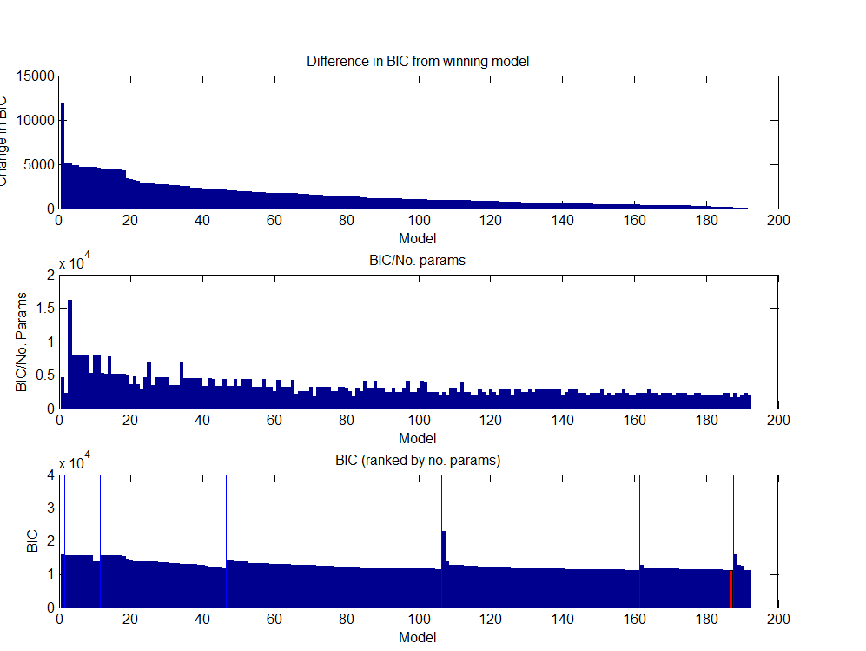
[Exp] Model space BICs

Slide 3
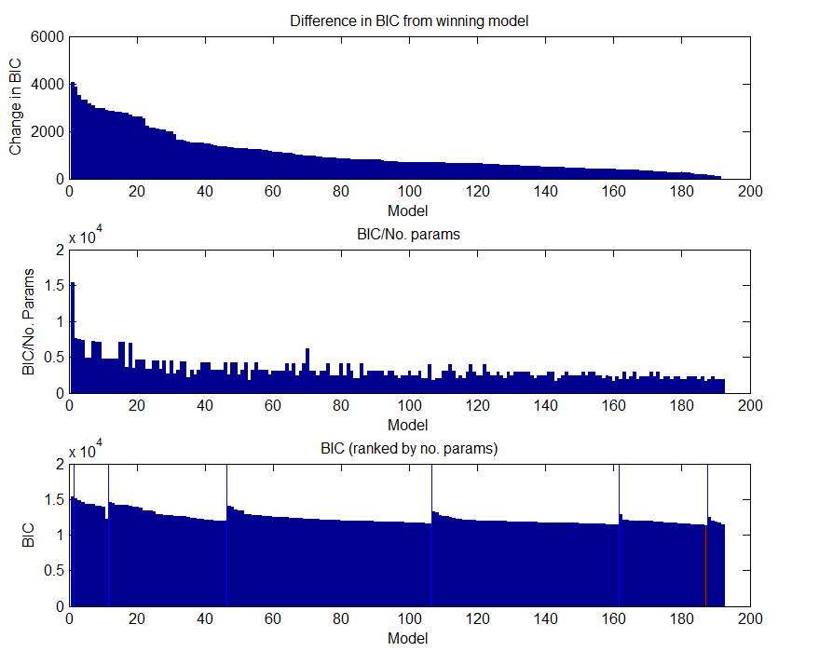
[Ctrl] Model space BICs

Slide 4
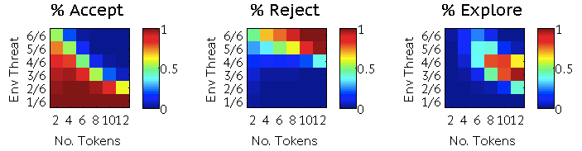
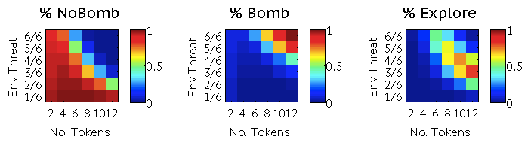
Predicted choice
Exp
Psuedo r2=0.65
Control
Pseudo r2=0.63

Slide 5
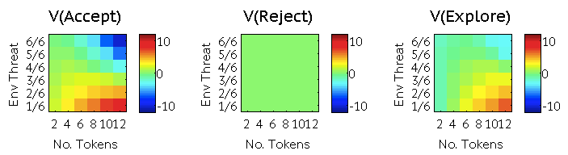
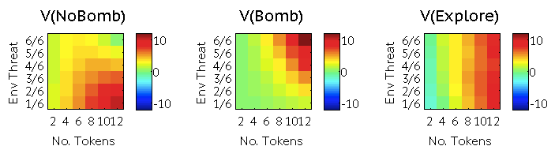
Values under winning model
Exp
Control

Slide 6
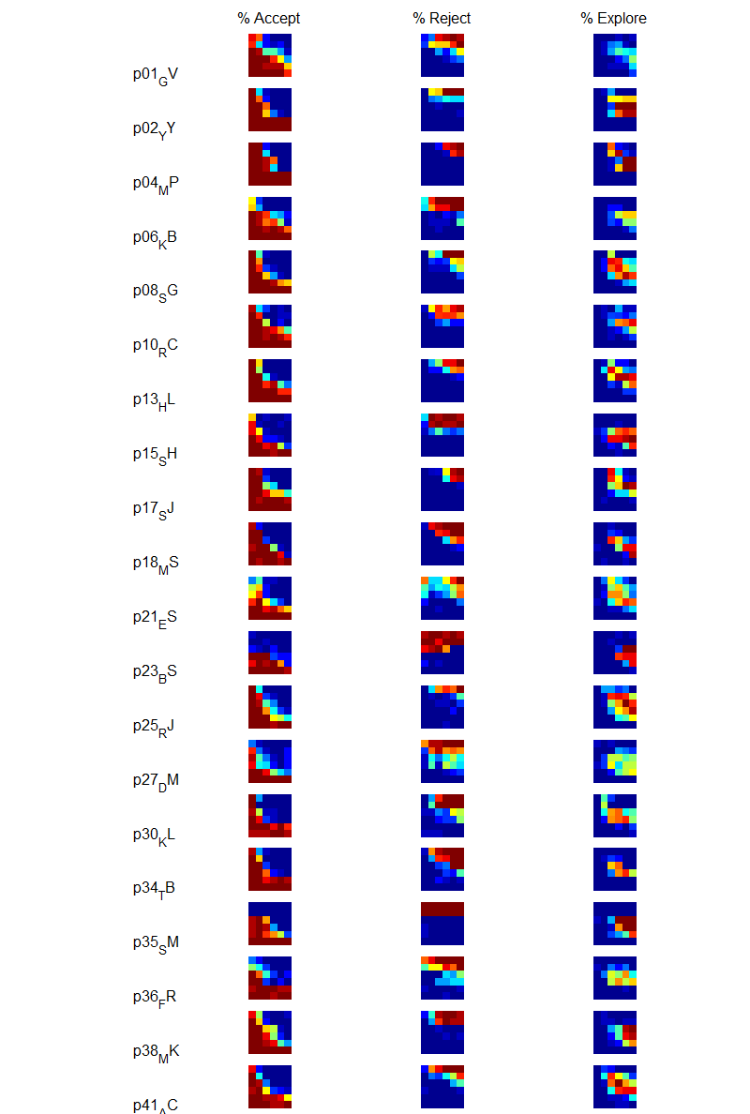
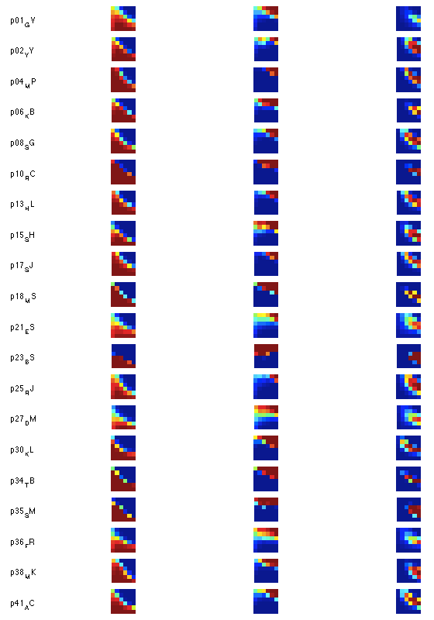
[Exp] Observed vs Predicted choice
Observed
Predicted (bpm16_feow)

Slide 7
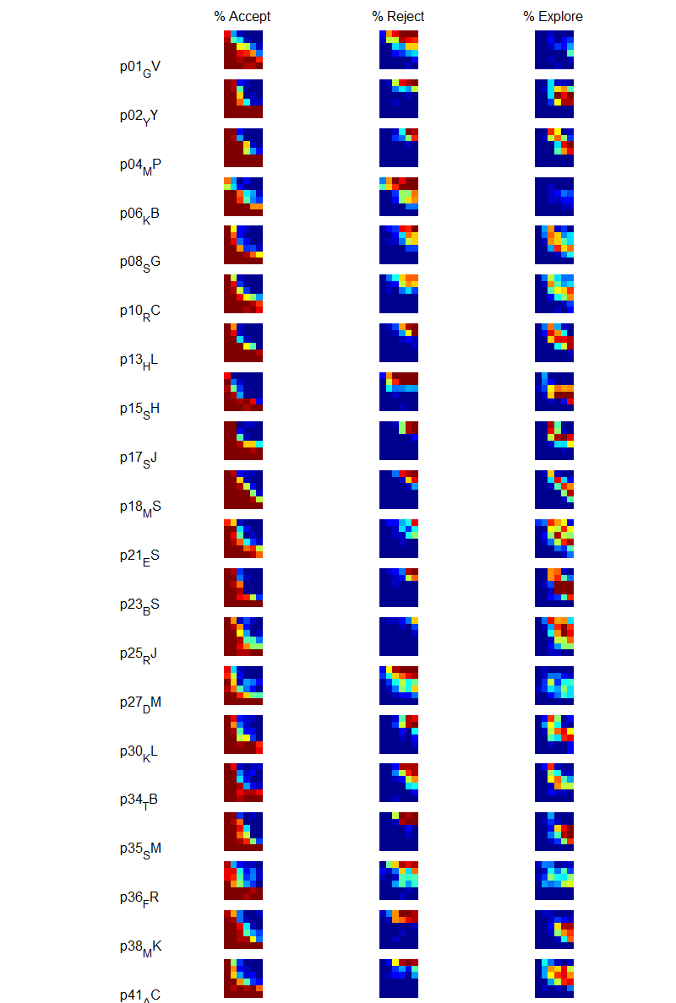
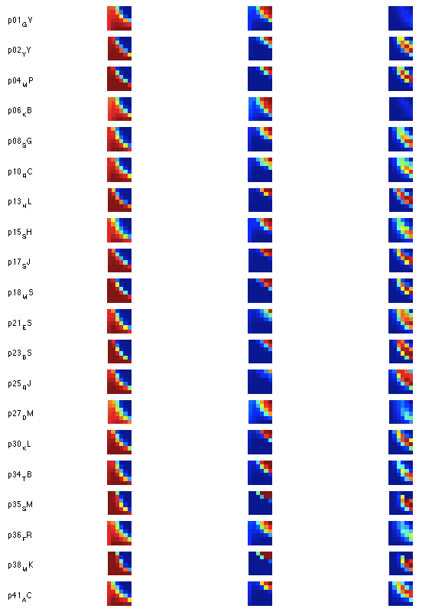
[Ctrl] Observed vs Predicted choice
Observed
Predicted (bpi11_euw)

Slide 8
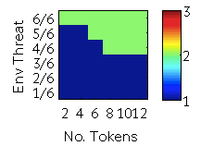
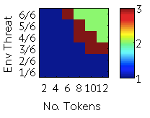
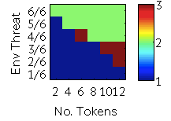

Best choice
Experimental: bpm16_feow
Control: bpi11_euw
Best choice
Best choice
under optimal model (b01)

